Slide 1

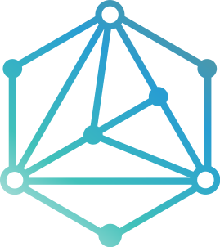
DREAM CATCHER
APPLICATION PROPOSAL
Prepared by: Brody Looney, Callie Samson, Elijah Story, Finn Jacobs, & Hunter McDaniels-Rossiter
GROUP 8

Slide 2
APPLICATION OVERVIEW
Dream Catcher is a productivity application that will be available on android.
This application will allow for users to create bucket lists and add tasks to these lists.
The user will be able to customize the lists according to the type of tasks that are within the list.
The user will be able to customize each list by assigning names, deadlines, and priority levels as well as attaching pictures and descriptions.
Users will be able choose if they want to share lists with other users so that users can find inspiration from others. Users can also create collaborative lists so that they can work together on finishing tasks.
The application will also feature a statistics section so that users can see certain things like how long a task or list took to complete as well as how many tasks are completed as well as not completed.
Project Proposal Presentation
Group 8
Notes:
Dream Catcher is a productivity application that will be available on android.
This application will allow for users to create bucket lists and add tasks to these lists.
The user will be able to customize the lists according to the type of tasks that are within the list. The user will be able to name the lists as well as attach pictures and descriptions.
The tasks will also be able to be customized. The user will be able to create deadlines for the tasks and also give each task a priority level.
Users will be able choose if they want to share lists with other users so that users can find inspiration from others. They will also be able to create collaborative lists so that users can work together on finishing tasks.
The application will also feature a statistics section so that users can see certain things like how long a task or list took to complete as well as how many tasks are completed as well as not completed.

Slide 3




SIMILAR APPLICATIONS
1
2
3
Bucket List Maker: Check Marks
Bucket: A Bucket List App
iBucket: Bucket List
This is a social media bucket list application. Users can make bucket lists that are filled with “buckets” and these lists can be shared to other users. Bucket is focused on the community within the application, users can find inspiration for their bucket lists by visiting the explore page or other users pages.
A bucket list app that is centered around travel. The user can make lists and add goals to these lists. Because it’s focused on travel, there is a map that will have a pin at all the places on your list. There is also a feature so you can track how many countries you have visited.
A free IOS/Android application with the main feature being the app's pre-made lists, which can be accessed after purchasing them. The app also allows you to create your own bucket lists and track your progress.
Project Proposal Presentation
Group 8
Notes:
Bucket List Maker: Check Marks: This is a free IOS/Android application with the main feature being the app's pre-made lists, which can be accessed after purchasing them. The app also allows you to create your own bucket lists and track your progress.
Bucket: A Bucket List App: This is a social media bucket list application. Users can make bucket lists that are filled with “buckets” and these lists can be shared to other users. Bucket is focused on the community within the application, users can find inspiration for their bucket lists by visiting the explore page or other users pages.
iBucket: Bucket List: This is a bucket list app that is centered around travel. You can make lists and add goals to these lists. Because it’s focused on travel, there is a map that will have a pin at all the places on your list. There is also a feature so you can track how many countries you have visited.

Slide 4


HOW DREAM CATCHER STANDS OUT
Dream Catcher promotes freedom for the user.
Lists can be created, styled, and named according to the users instructions.
Users can choose to create private or public lists so that they are in control over who is able to view them.
Dream Catcher will help you reach your goals and complete your tasks by pushing motivational messages during and upon completion of each task.
Project Proposal Presentation
Group 8
Notes:
The main difference between our application and other similar applications is that our application promotes freedom for the users. Lists can be created, styled, and named according to the users instructions.
Our application promotes freedom in the sharing sense as well. Users can choose to make their lists private or public so that they are in control over who is able to view them.
This application will also feature something that the similar applications don’t address and that is motivation to complete their tasks within the list. Our application will feature motivational messages about their tasks prior to completion as well as upon completion of a task.

Slide 5


MAIN USER STORIES
As a user I want to be able to create separate folders within the application so that I can put certain events/plans in specific categories.
As a user I want to be able to have the option to share my bucket list with friends and other users of the application so that they can see my list.
As a user I want the ability to set up a collaborative bucket list so that my friends or significant other can add things we wish to do together.
Project Proposal Presentation
Group 8
Notes:
As a user I want to be able to create separate folders within the application so that I can put certain events/plans in specific categories.
As a user I want to be able to have the option to share my bucket list with friends and other users of the application so that they can see my list.
As a user I want the ability to set up a collaborative bucket list so that my friends or significant other can add things we wish to do together.

Slide 6
MAIN USER STORIES
(continued)
As a user I want to be able to add a deadline to an entry so that I am motivated to complete the task.
As a user I want to be able to have the option to attach a picture with my entries so that I can have a visual representation of my entry.
As a user I want to be able to sort my entries based on priority so that I know which entries I would like to complete first.
Project Proposal Presentation
Group 8
Notes:
As a user I want to be able to add a deadline to an entry so that I am motivated to complete the task.
As a user I want to be able to have the option to attach a picture with my entries so that I can have a visual representation of my entry.
As a user I want to be able to sort my entries based on priority so that I know which entries I would like to complete first.

Slide 7
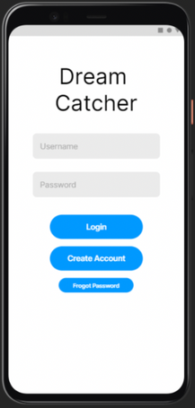
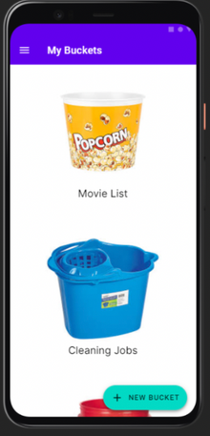
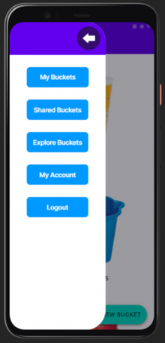
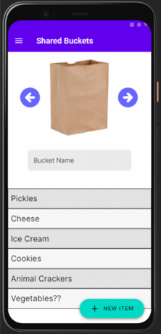
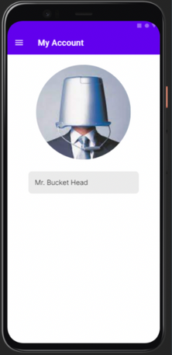

USER INTERFACE MOCK-UP
Project Proposal Presentation
Group 8
Notes:
When designing our preliminary user interface some goals we had were to keep it simple, intuitive, fun, engaging, and customizable for each user.
From left to right we have the initial screen a user would see, the login & signup screen.
Next is the catalog of bucket lists, specific to each user.
The middle image is the menu, accessible from the 3 horizontal lines in the top left corner.
The next image, with the brown paper bag is an example of a shared bucket, these users are sharing a list of food, and each user can add a new item to the list by tapping the “new item” button in the bottom right corner.
Finally, the last is what users will see as their profile screen. From here they can customize their profiles including name and image!

Slide 8
Q&A
If anybody has any questions about "Dream Catcher", we would be happy to answer them at this time!
Project Proposal Presentation
Group 8
Notes:
If anybody has any questions about Dream Catcher our team would be happy to answer them at this time!

Slide 9
Thank you!
Project Proposal Presentation
Group 8
Notes:
Thank you all for your attention, we are looking forward to your feedback!

